Slide 1
Data Collection and Analysis
Loan Data Analysis
Avaiya Jensi

Slide 2
Data analysis
Collection
Cleaning
Visualization
Prepare data,Collection Of data
Fill Null Value, Remove Outliers , Duplicate Value
Graphical representation of data insights.

Slide 3
Understand Data
Loan Data
Loan Id | The "Loan_ID" column likely contains unique identifiers assigned to each loan application in the dataset.
Gender | Male/Female
Married | Married/Unmarried (Yes/No)
Dependents | The "Dependents" column likely denotes the number of dependents (such as children or other family members) the applicant financially supports.
Education | Graduate or Not Graduate.
Self imployed | The "Self_Employed" column typically denotes whether the loan applicant is self-employed or not.
ApplicantIncome | The "ApplicantIncome" column contains the income of the primary applicant (in monetary units) for the loan application.
CoapplicantIncome | The "CoapplicantIncome" column typically represents the income of the co-applicant or secondary applicant (if any) for the loan application.
LoanAmount | The "LoanAmount" column typically represents the amount of money requested by the applicant as a loan.
Loan_Amount_Term | The "Loan_Amount_Term" column indicates the duration, in months, for which the loan amount is borrowed. It specifies the agreed-upon time period for repayment of the loan.
Credit_History | The "Credit_History" column typically denotes whether the loan applicant has a credit history,
Property_Area | Urban,Semiurban or Rural
Loan_status | Loan status is in Y or N.

Slide 4
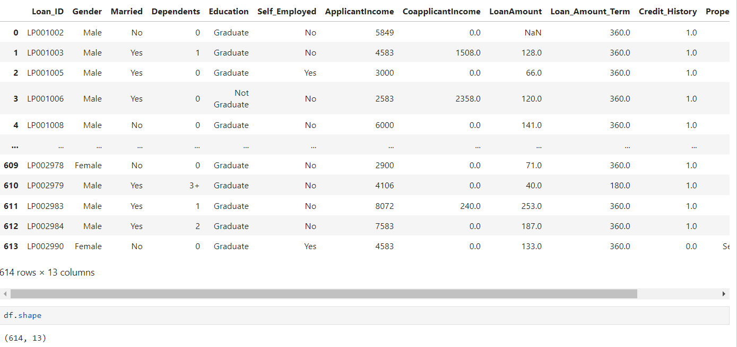
Loan Data

Slide 5
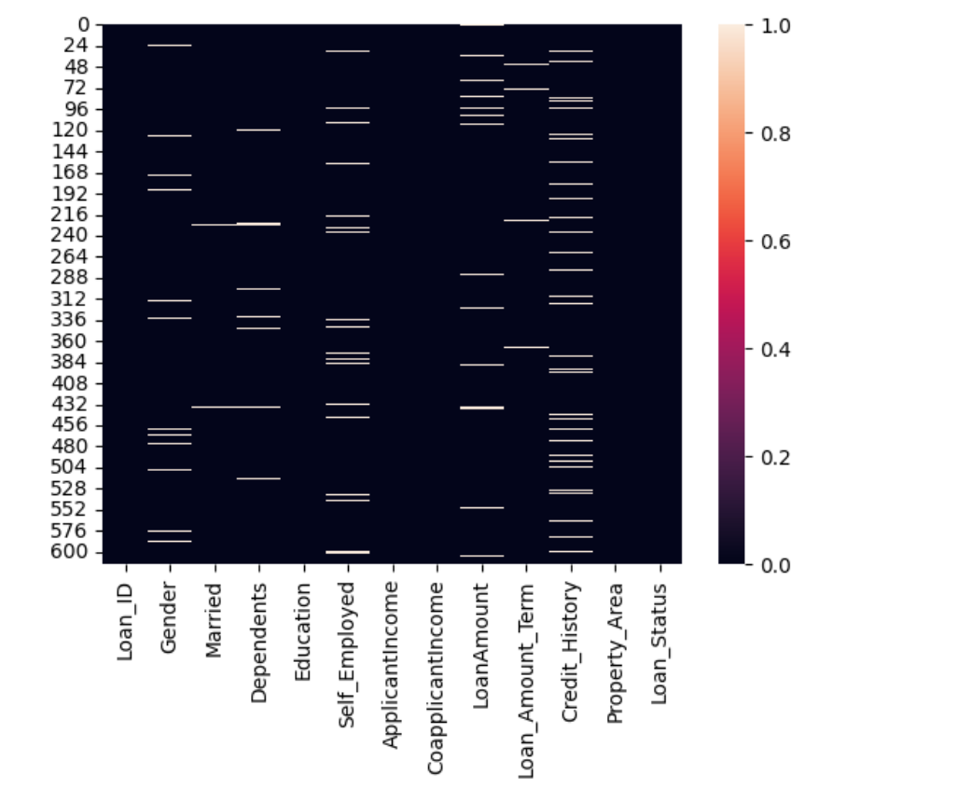
Null Value
Loan_ID :0
Gender :13
Married :3
Dependents :15
Education: 0
Self_Employed :32 ApplicantIncome :0 CoapplicantIncome: 0 LoanAmount: 22 Loan_Amount_Term: 14 Credit_History : 50 Property_Area : 0 Loan_Status : 0

Slide 6
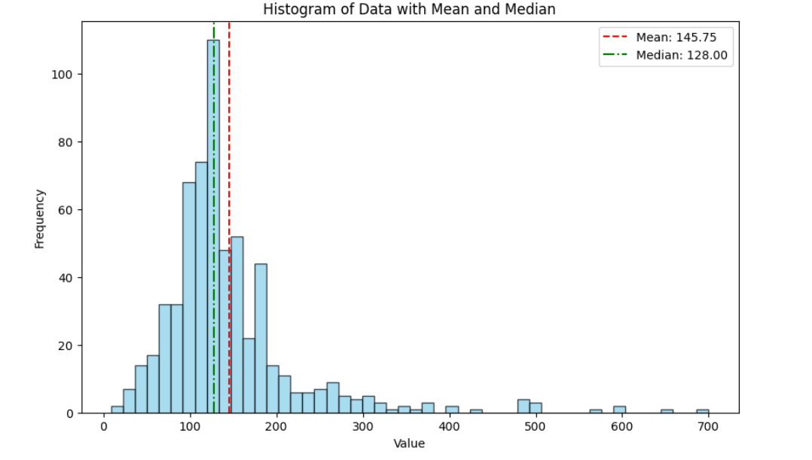
Fill Value

Slide 7
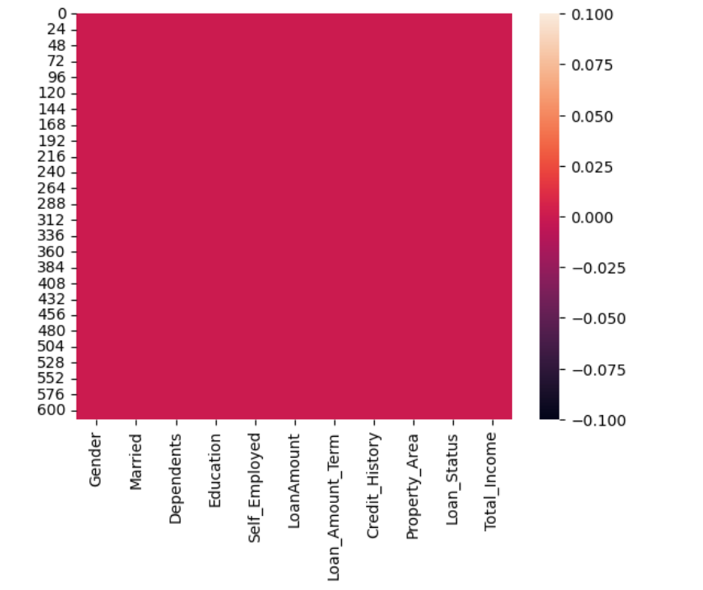
Null Or Not-null

Slide 8
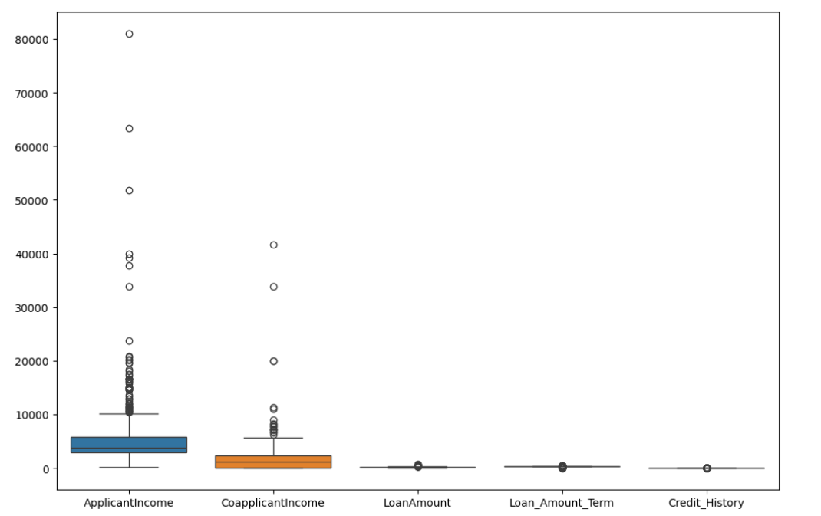
Find Outliers

Slide 9
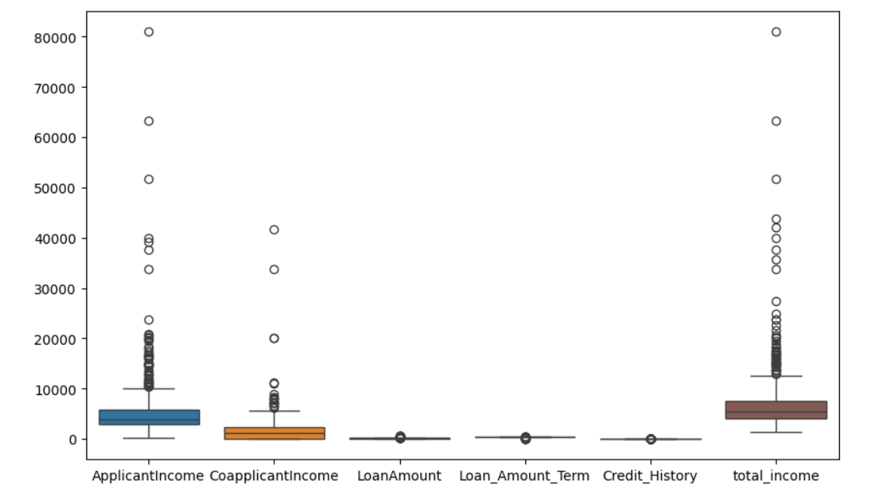

Slide 10
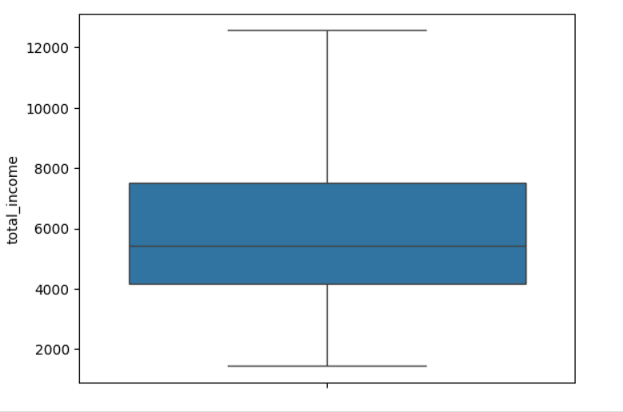
Remove Outliers

Slide 11
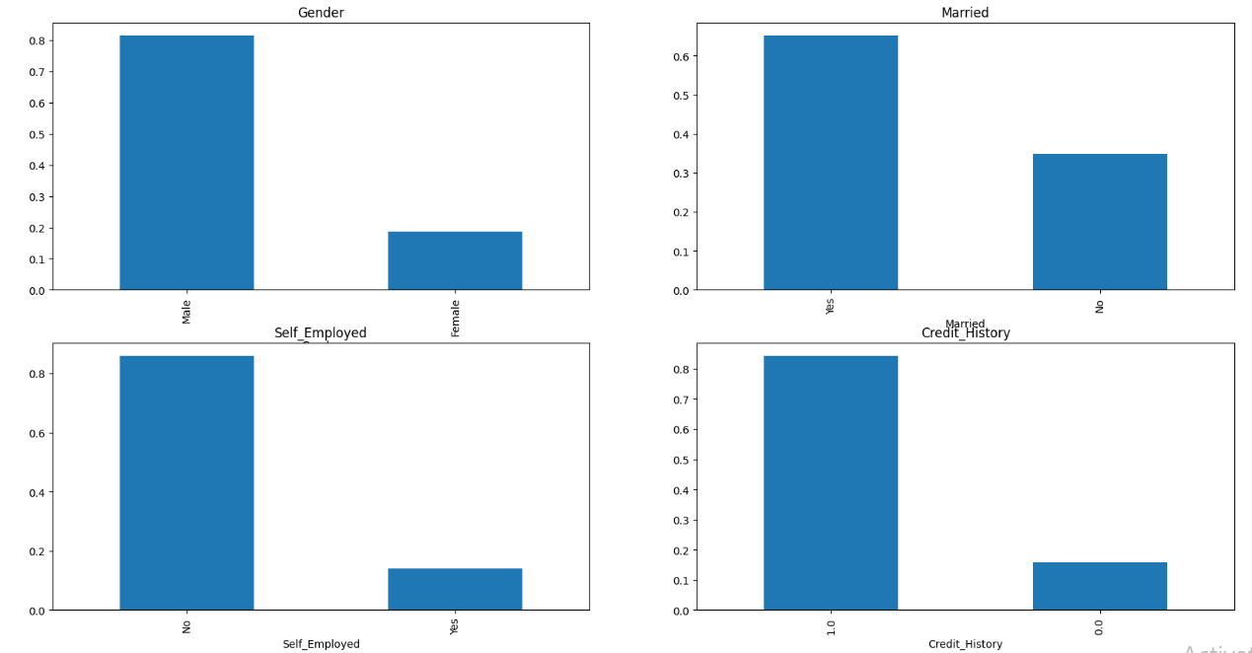
Categorical Data
Categorical data refers to data that represents categories or groups.

Slide 12
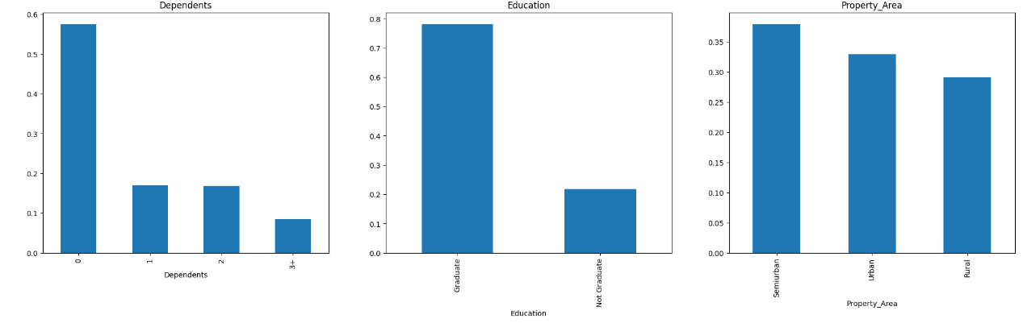
Ordinal Data
Ordinal data is categorical data with a natural order or ranking.

Slide 13
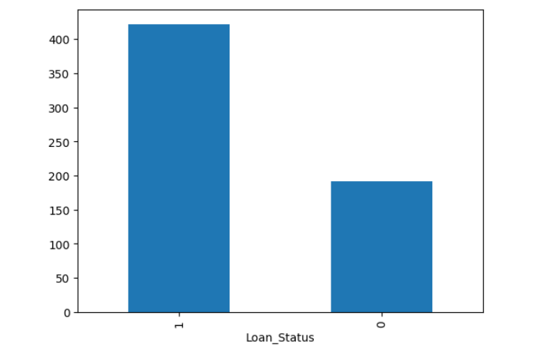
Loan Status

Slide 14
Logistic Regression
Logistic regression is a supervised machine learning algorithm used for binary classification tasks.
Dependent Variable: X
Gender , Married , Dependents , self employed ,Loan amount , Loan amount term
,Credit History , Property Area , Loan Status , Total Income
Target Variable:y
Loan Status

Slide 15
Sklearn Library and Its Used
Train test split
Standard Scalar
from sklearn.model_selection import train_test_split
from sklearn.preprocessing import StandardScaler
Divide Data, assess model with train/test sets,ensure accuracy.
Normalize Feautures ,center data to mean,scale to variance.

Slide 16
Sklearn Library and Its Used
Logistic Regression
Accuracy Score
from sklearn.linear_model import LogisticRegression
from sklearn.metrics import accuracy_score
Statical Model for binary classification,estimating probability using logistic function.
Metrix assessing model perfomance by comparing predicted labels to actual.

Slide 17
Sklearn Library and Its Used
[ ]
[19 24],
[2 109]
Confusion Matrix
Prediction=83%
from sklearn.metrix import
Accuracy score
19 – Most Positive Value
24 – positive Negative value
2 – Negative Positive Value
109-Most Negative Value
Classification Summery.

Slide 18
Thanks!
Do you have any question?

